Slide 1
Quantum Computing Hackathon July 2023
on
Noise Model Simulation of QKD Protocols using QSim
Organized by IIIT Roorkee and CDAC Hyderabad
Submitted by
Team
Noise Model Simulations of QKD Protocols using QSim
Participants
of
Quantum Computing using Indigenous Quantum Simulator QSim
Dr. Ajanta Das
Amity University Kolkata,
Newtown, Kolkata 700135
Email: ajanta.desarkar@gmail.com
Varsha Chakraborty
University of Engineering & Management
Newtown, Kolkata 700160
Email: chakrabortyvarsha1@gmail.com

Slide 2
Introduction
Quantum Key Distribution (QKD) protocols provide secured Quantum communication
QKD uses classical channel and quantum channel
Interference or noise may occur in quantum circuit
Quantum systems are highly sensitive to disturbances from the environment
A security interface between the classical and quantum network is necessary

Slide 3
Motivation
From literature, it is evident that analysis of noise models of QKD protocols is essential for fault tolerant quantum communication
Quantum computers are expensive and difficult to access
Programming in Quantum computers are different than that in classical computers
Crucial to evaluate the QKD protocol in real platform of quantum computer
Quantum simulators – QASM and QSim are chosen for analysis and modeling

Slide 4
Objective
Study and Implementation of QKD protocols
BB84, the first QKD protocol
Differential Phase Shift (DPS)
Chosen Quantum Simulators
IBM Quantum assembly language, QASM
Qsim built by IISc Bangalore and IIT Roorkee and C-DAC
Execution of Noise models of the QKD Protocols in simulators
Circuit Noise, Bit Flip
Channel Noise, Depolarization

Slide 5
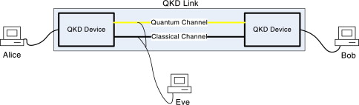
Quantum Key Distribution
Quantum Key Distribution
uses a series of photons to transmit data over a fiber optic
to guarantee a secure key agreement
Alice and Bob generate a secret key by sending qubits
Utilizes classical channel and quantum channel
Eavesdropping may happen by Eve

Slide 6
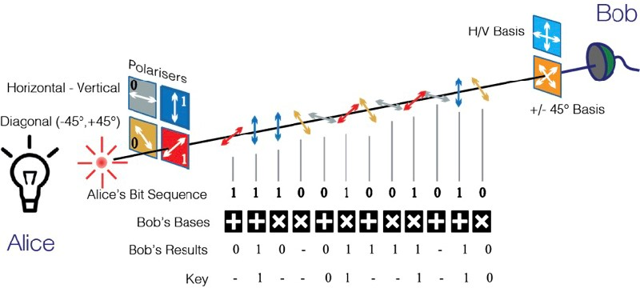
BB84 Protocol
First quantum cryptography protocol, proposed by Charles Bennett and Gilles Brassard in 1984
based on Quantum Key Distribution, polarization and no cloning theorem

Slide 7
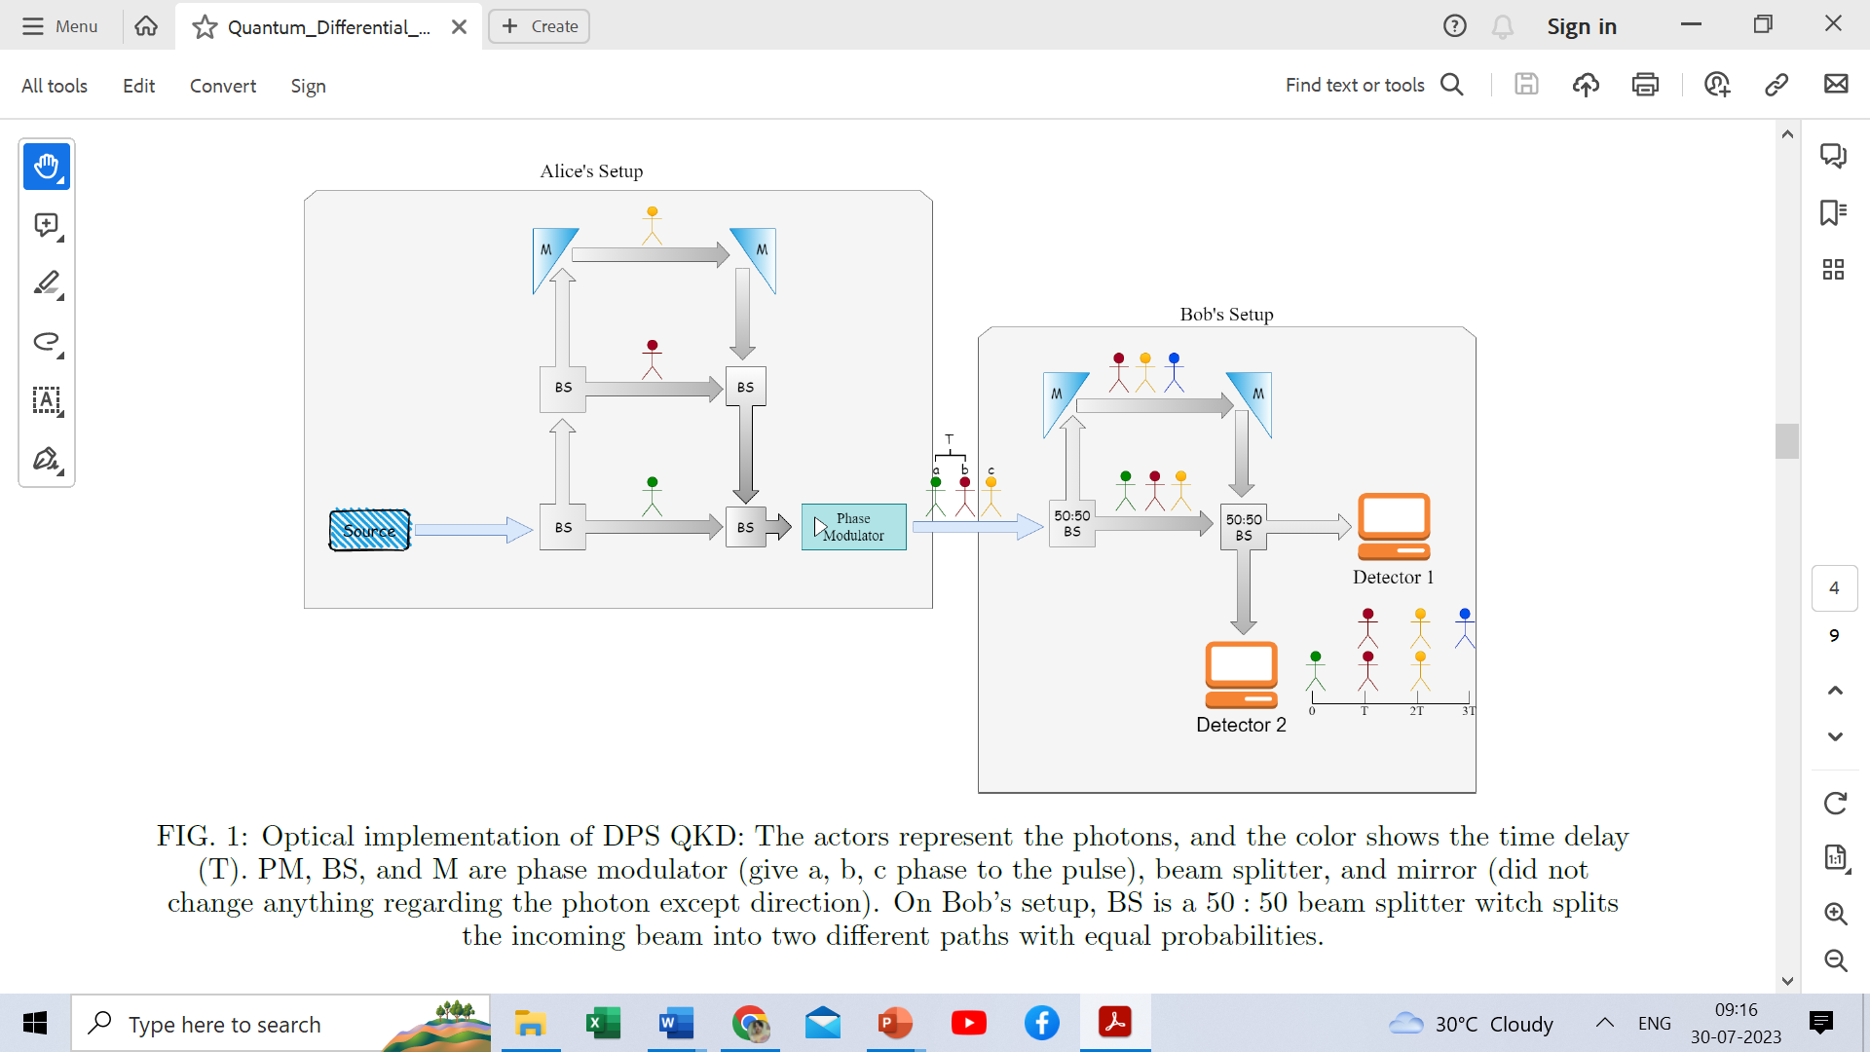
DPS Protocol

Slide 8
Noise in Quantum Communication
Circuit Noise
Bit Flip - flipping the bit values to 1 from 0 or vice versa; X gate is used
Phase Flip – phase changes due to physical parameters and superposition; Z gate is used
Channel Noise
Depolarization – due to hardware infidelity; X, Y, Z and I gates are used
Amplitude Damping – energy dissipation or loss of photon
Phase Damping – loss of information
Decoherence - due to thermal relaxation, decoherence occurs

Slide 9
QASM Vs QSim
QASM, developed by IBM Quantum Composer in 2020
Drag and drop and prepare the quantum circuit
Prototyping 32 qubits qubits quantum circuits, algorithms and noise models
In India, the first initiative of Govt. of India to propose QSim in 2020-2021
QSim is proficient by C-DAC, IISc Bangalore and IIT Roorkee
Provides a graphical user interface to easily explore quantum computing with 10 qubits

Slide 10
QASM Environments
Provider | qiskit-ibmq-provider0.19.1
Simulator | qiskit-aer0.10.4
Languages | qiskit0.36.2; Python version 3.8.12
Compiler | Python compiler GCC 9.4.0
Operating System | Linux
CPU | 2
Memory | (Gb)6.783603668212891

Slide 11
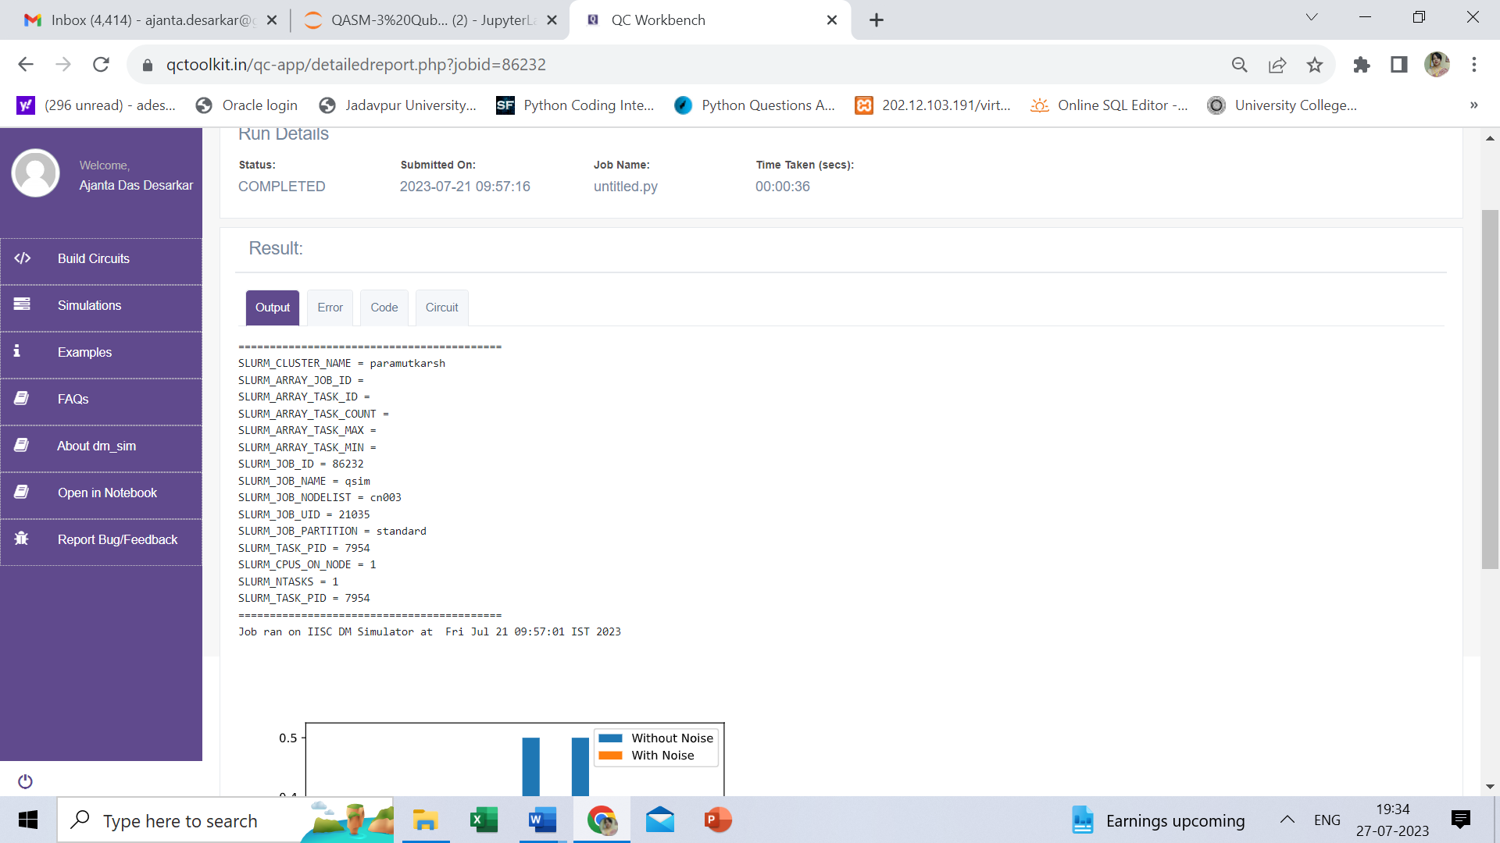
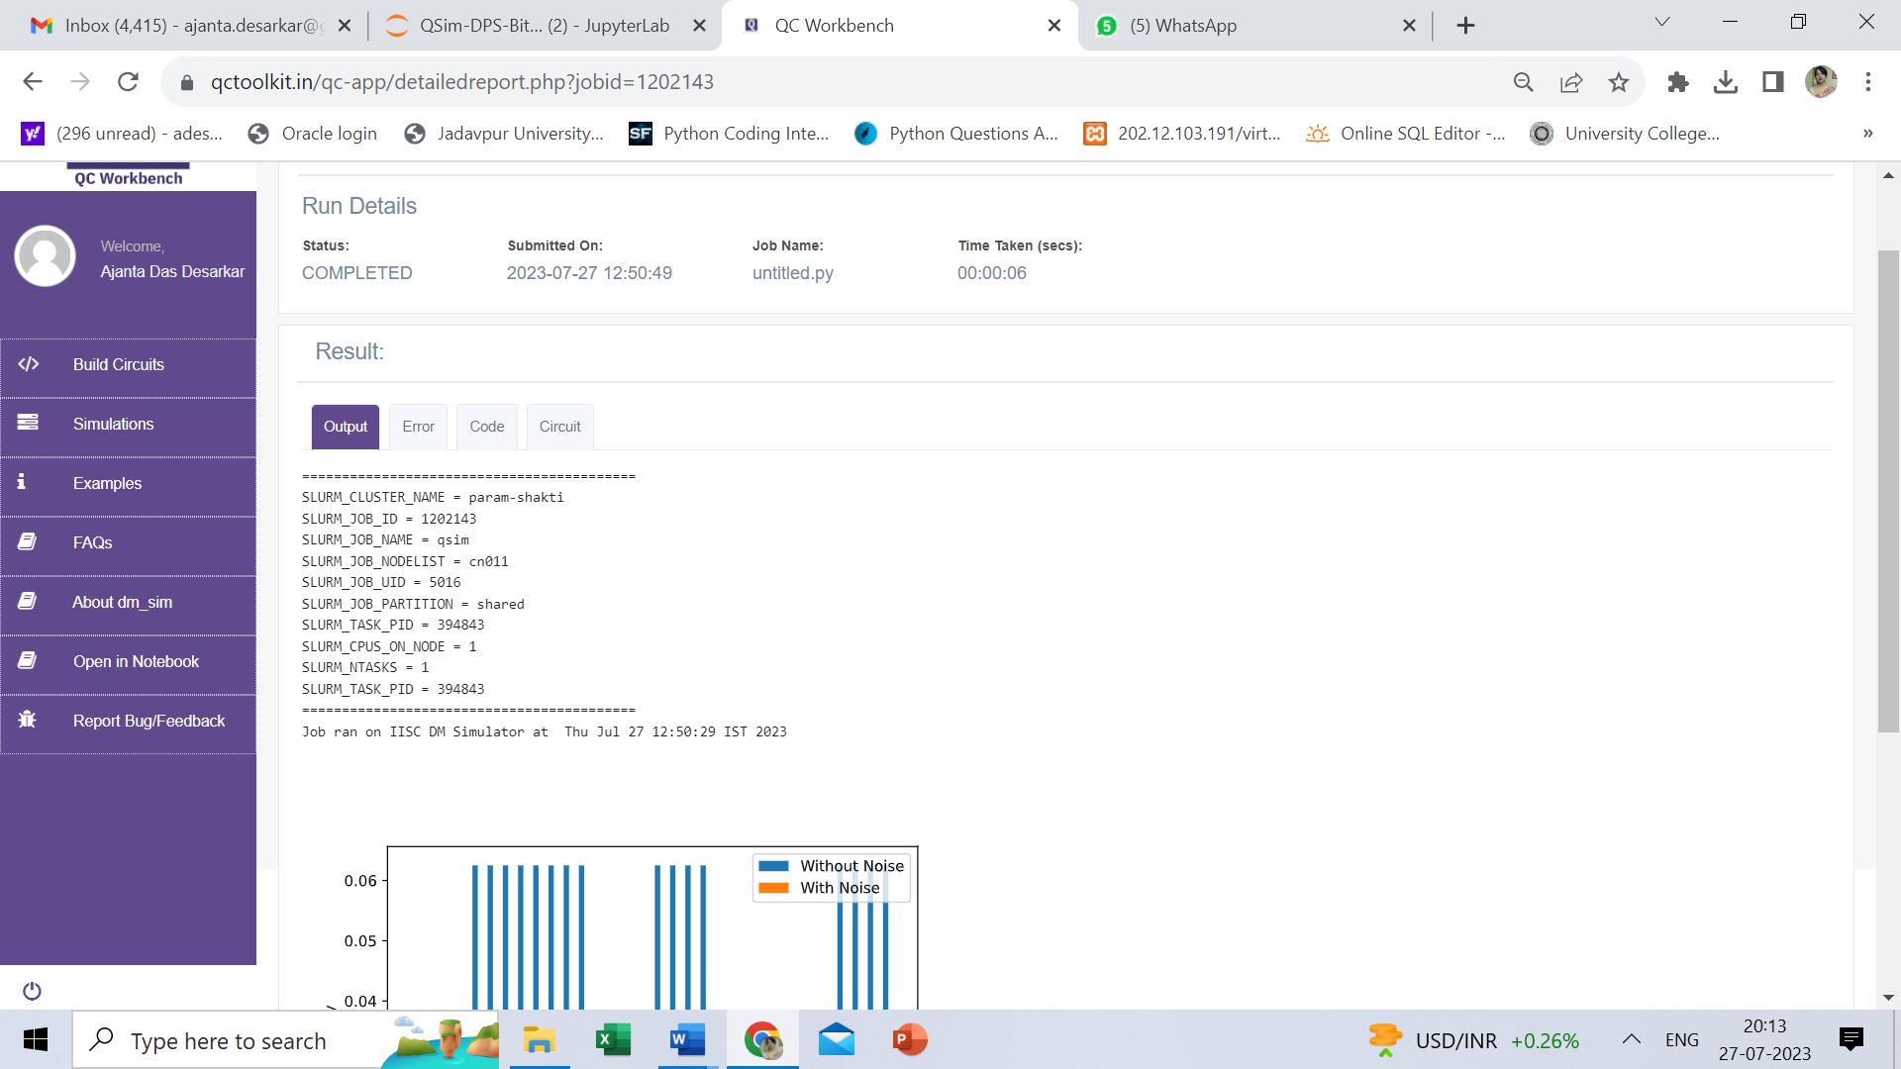
Qsim Environements
Selected Backend PARAM UTKARSH
Snapshot of execution of one Job
Selected Backend PARAM SHAKTI
Snapshot of execution of one Job

Slide 12
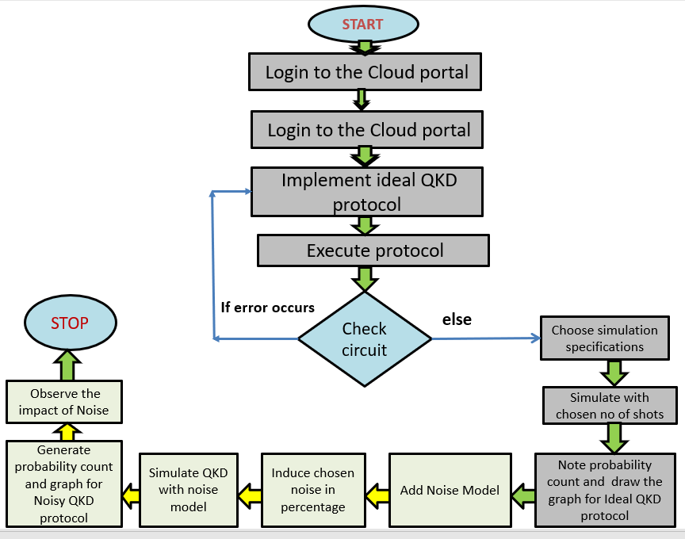
Flowchart of Methodology

Slide 13
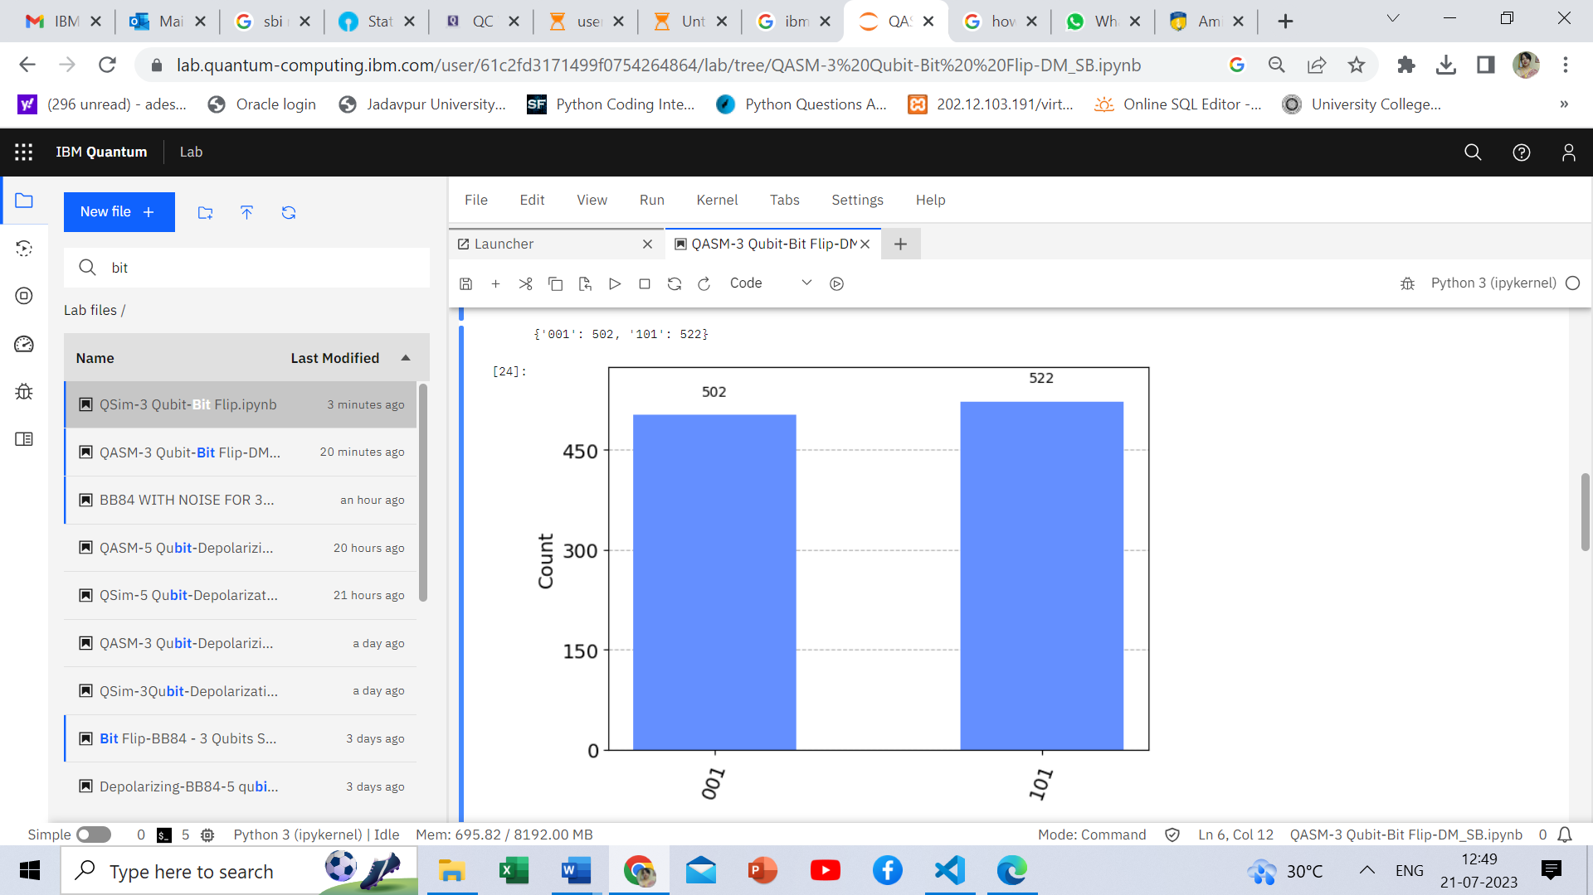
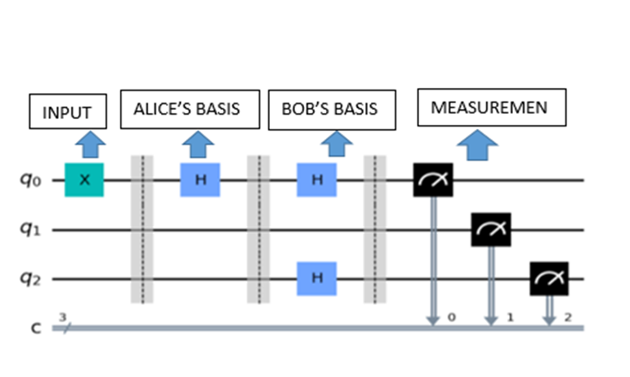
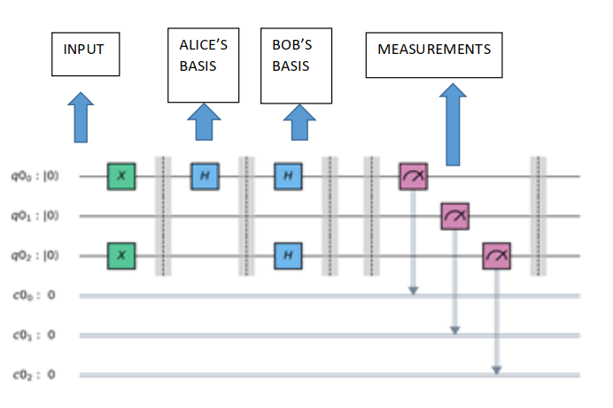
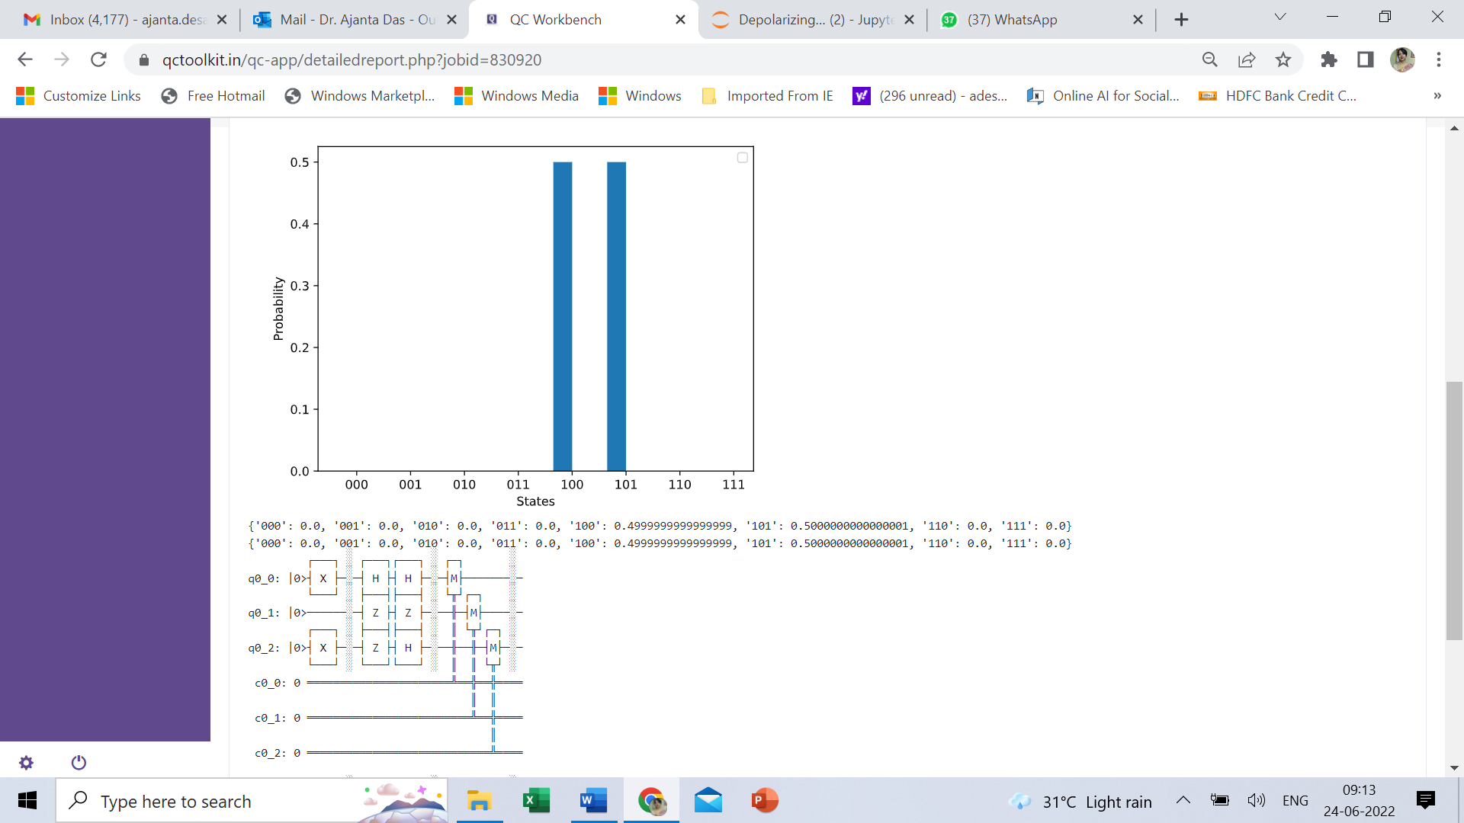
Ideal BB84 - QASM Vs QSIM using 3 Qubits
QASM
QSIM

Slide 14
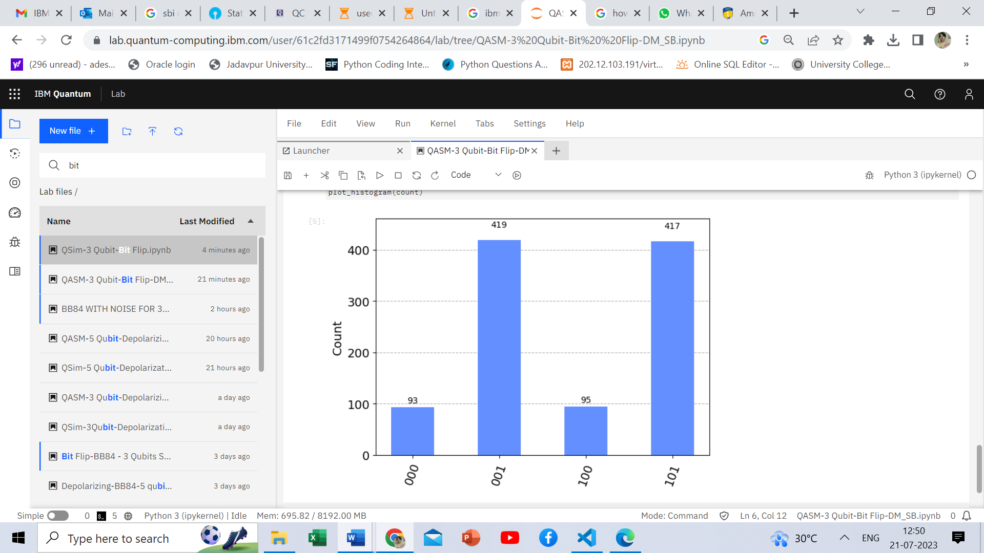
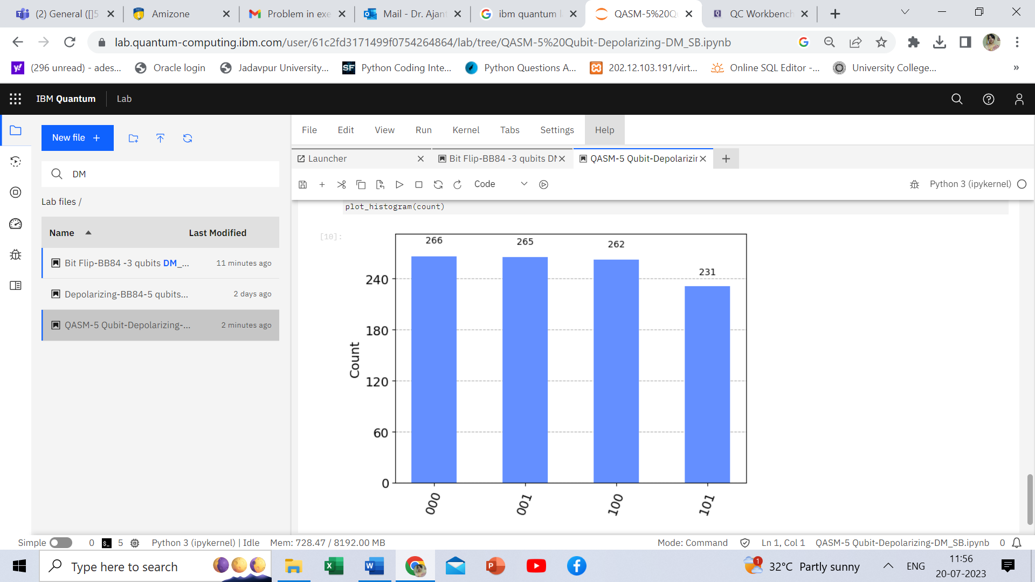
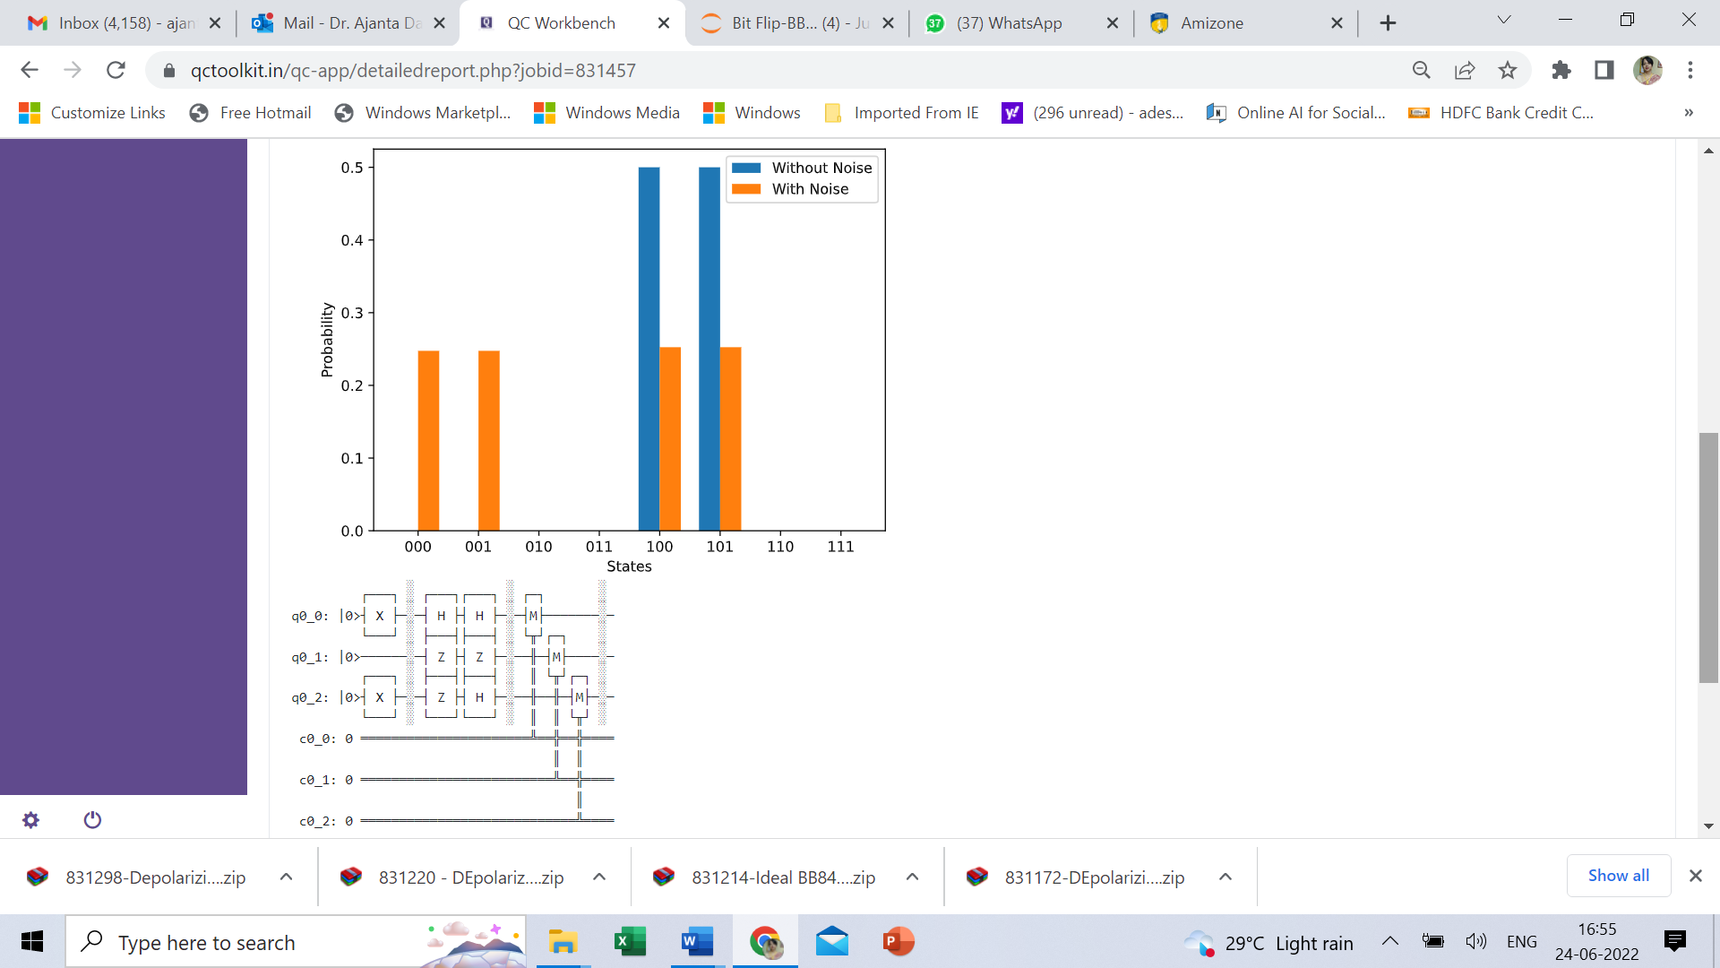
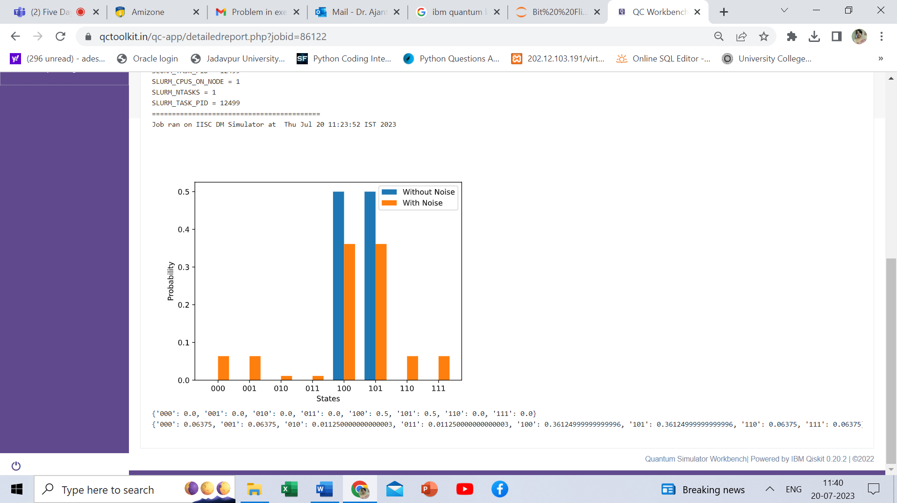
Noise Models - QASM Vs QSIM BB84 - using 3 Qubits
DEPOLARIZATIO
N
BIT
FLIP
QASM
70%=0.7
10%=0.1
QSIM

Slide 15
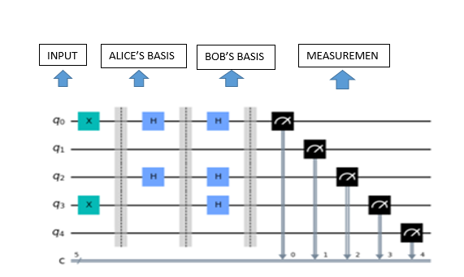
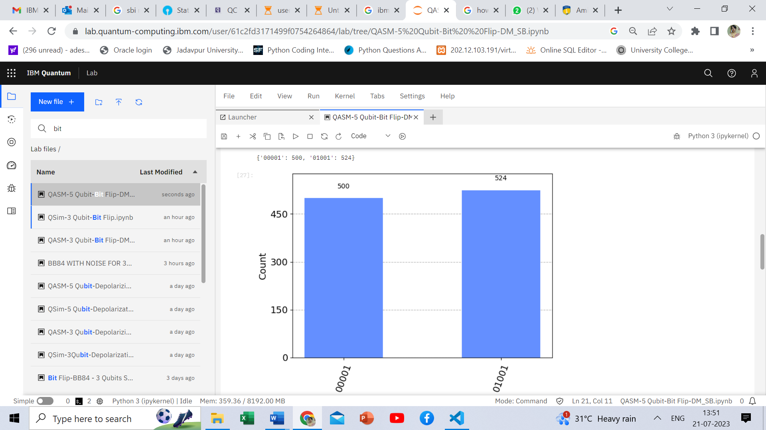
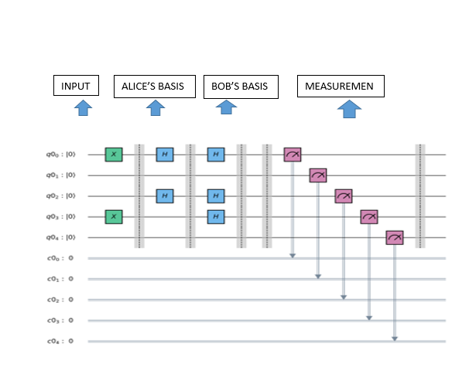
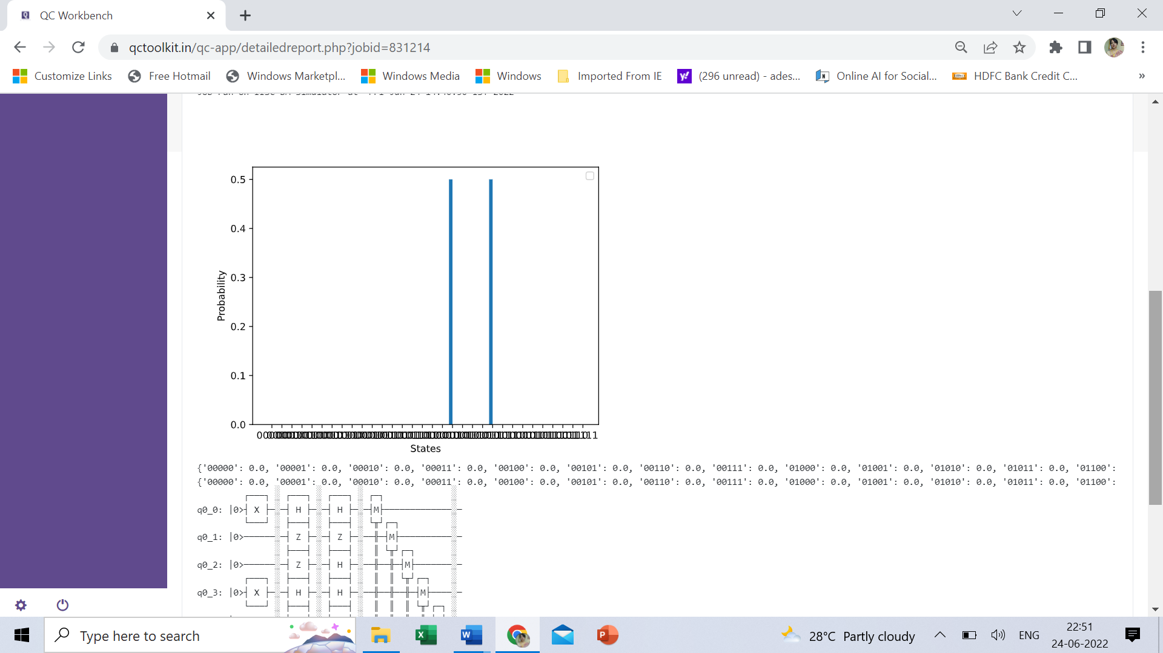
Ideal BB84 - QASM Vs QSIM using 5 Qubits
QASM
QSIM

Slide 16
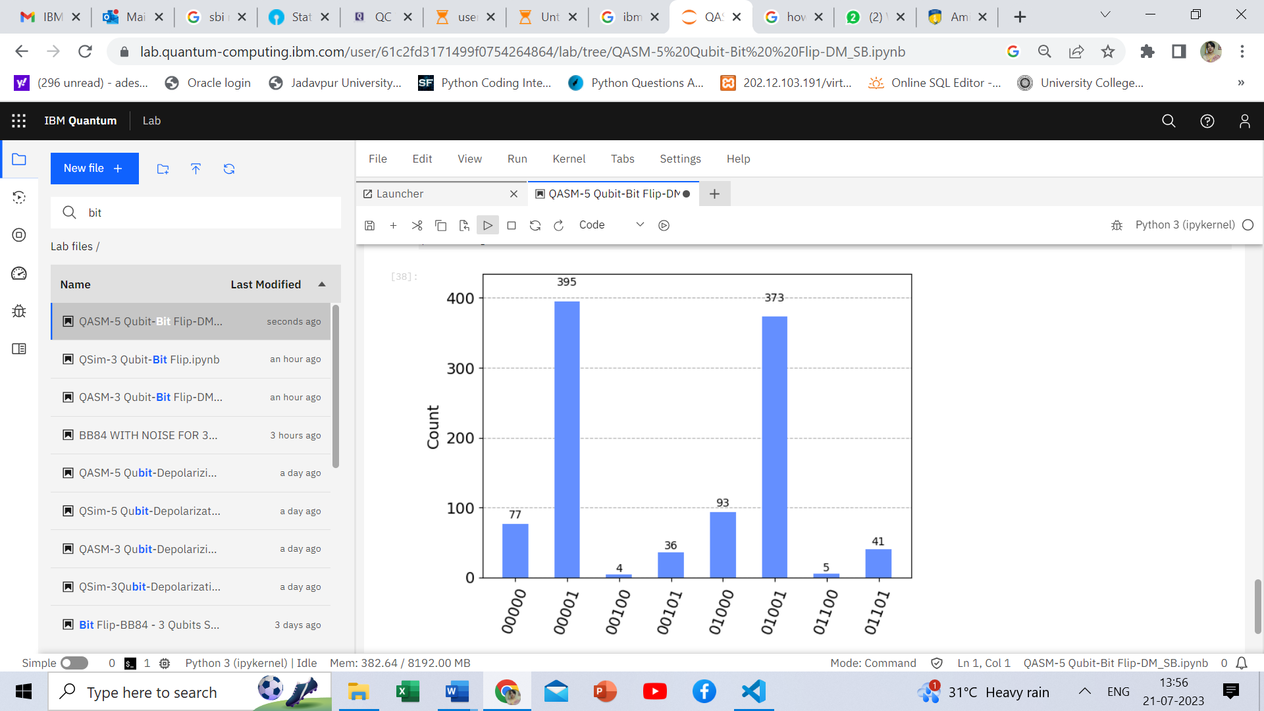
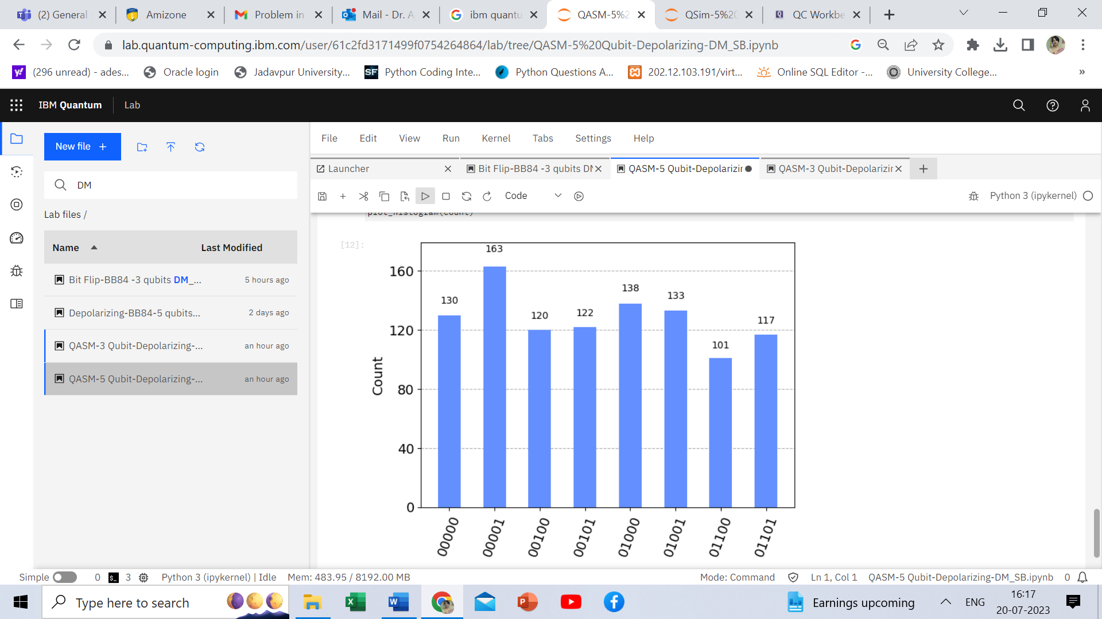
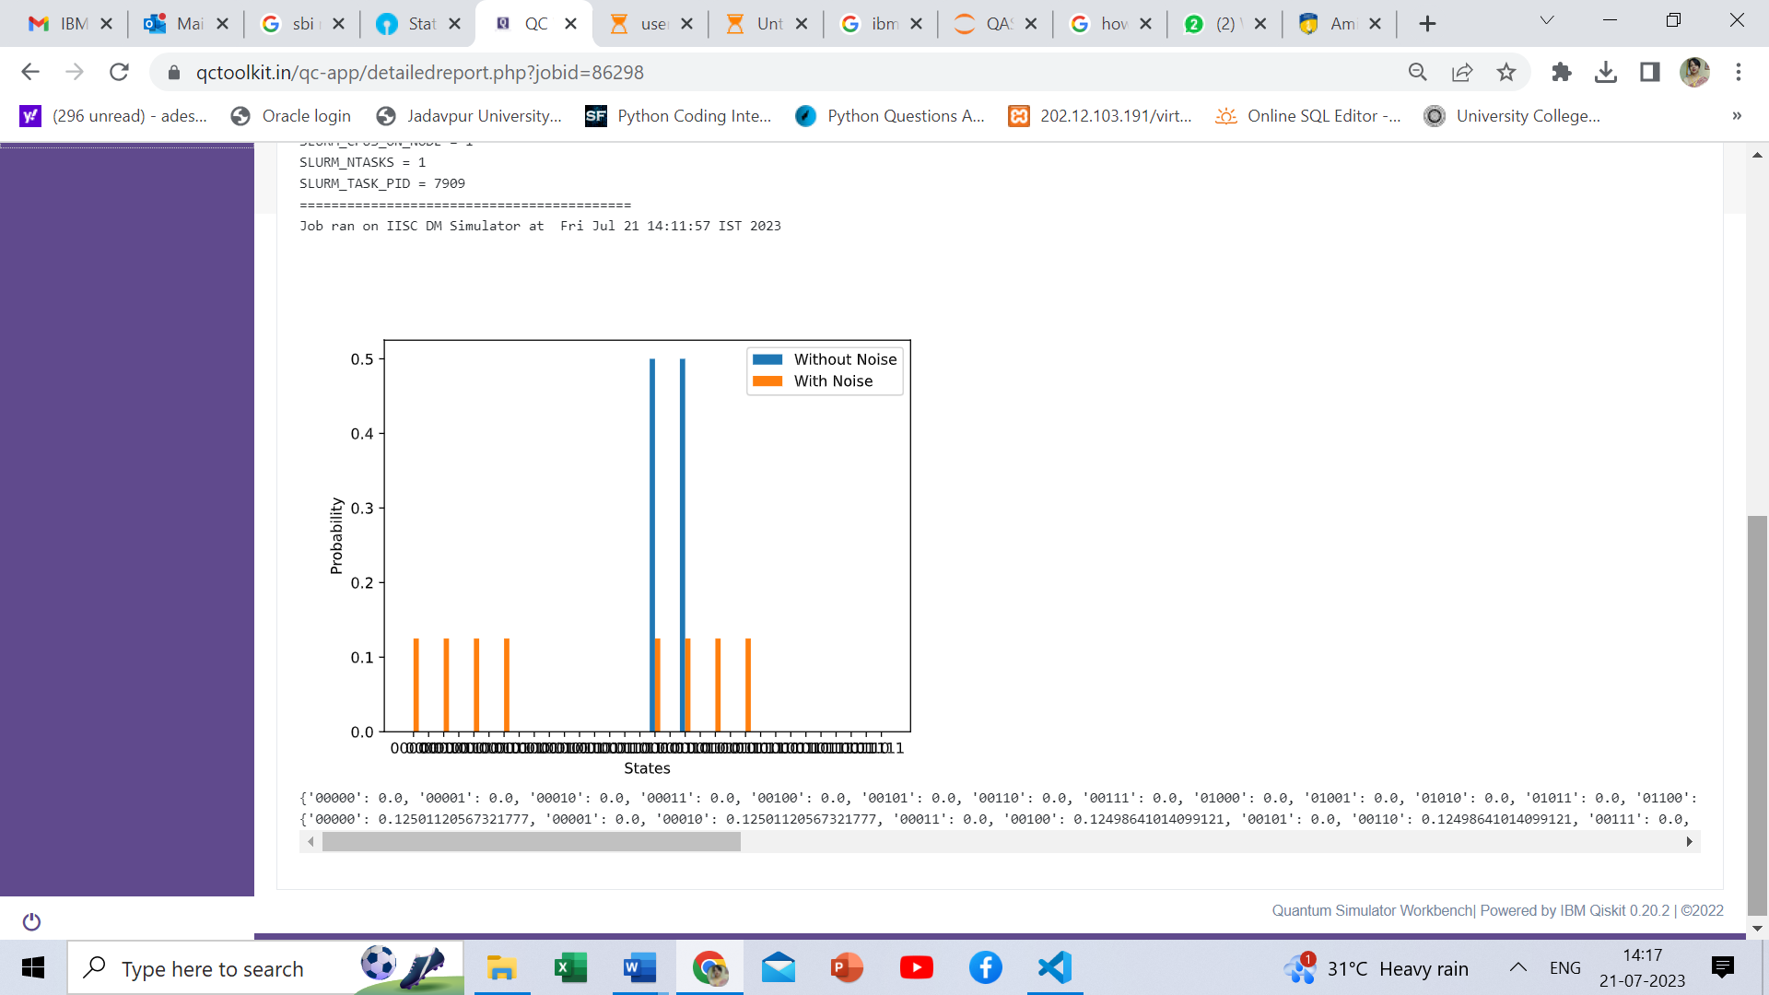
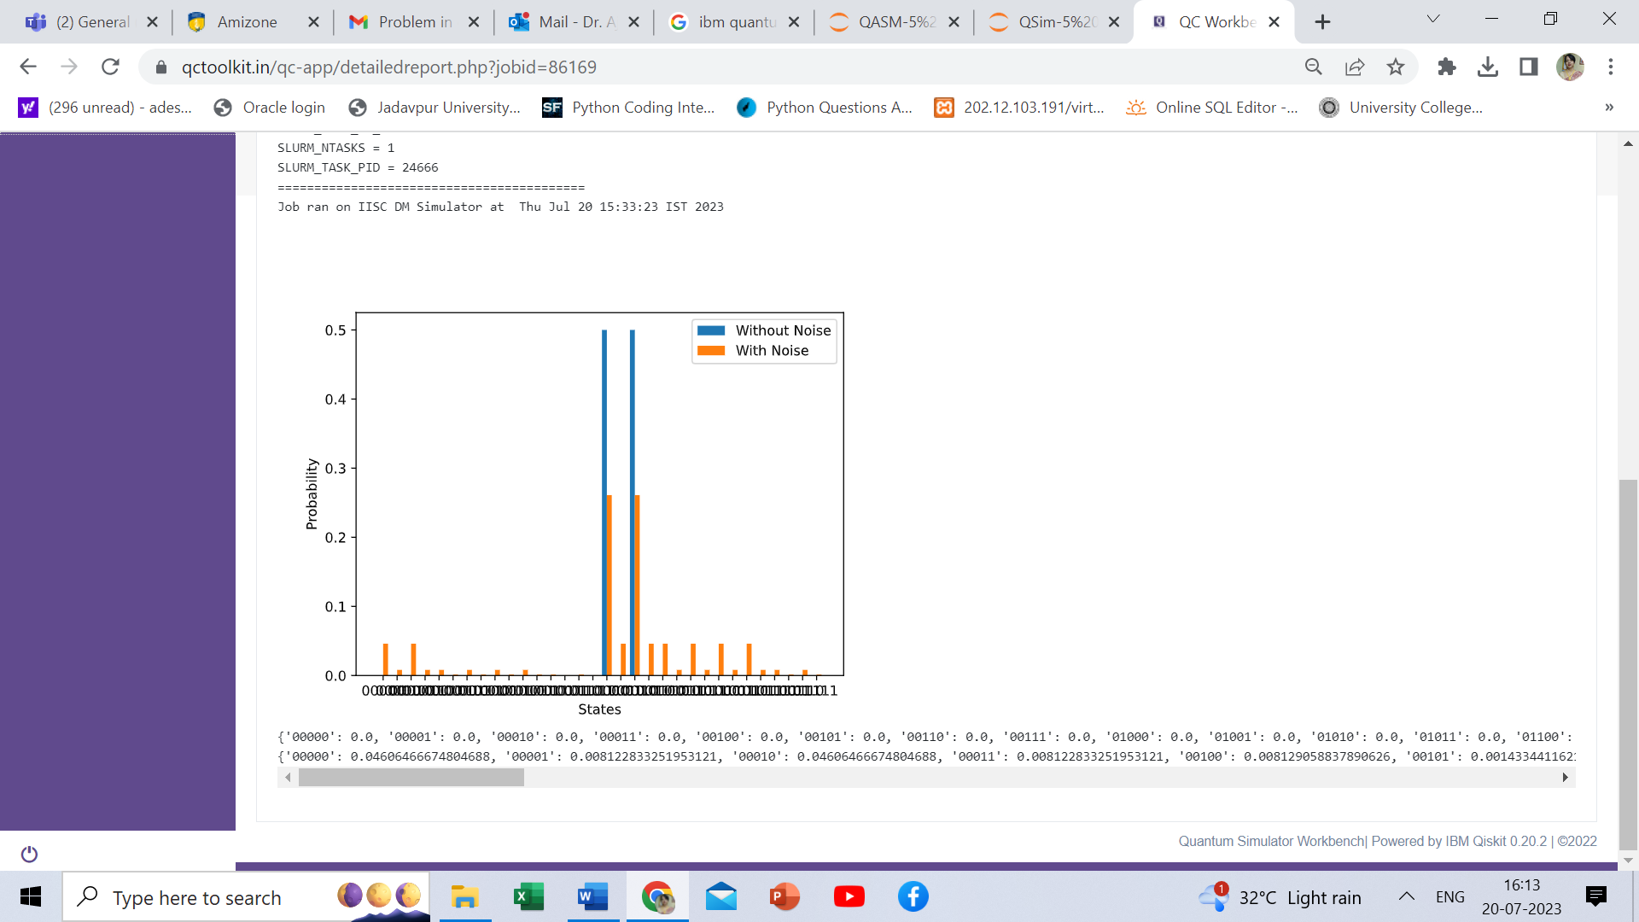
Noise Models - QASM Vs QSIM BB84 - using 5 Qubits
DEPOLARIZATIO
N
BIT
FLIP
10%=0.1
QASM
70%=0.7
QSIM

Slide 17
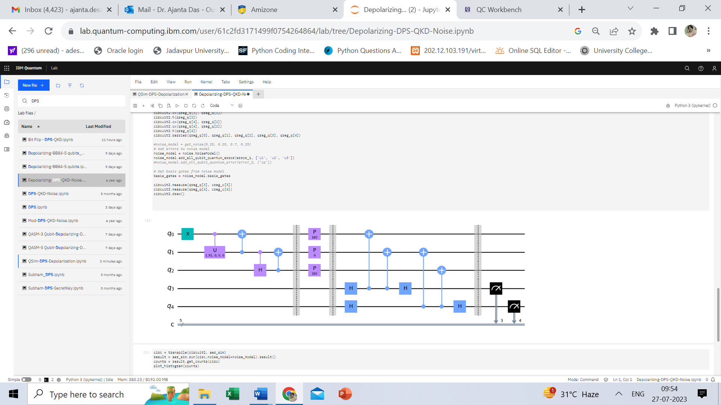
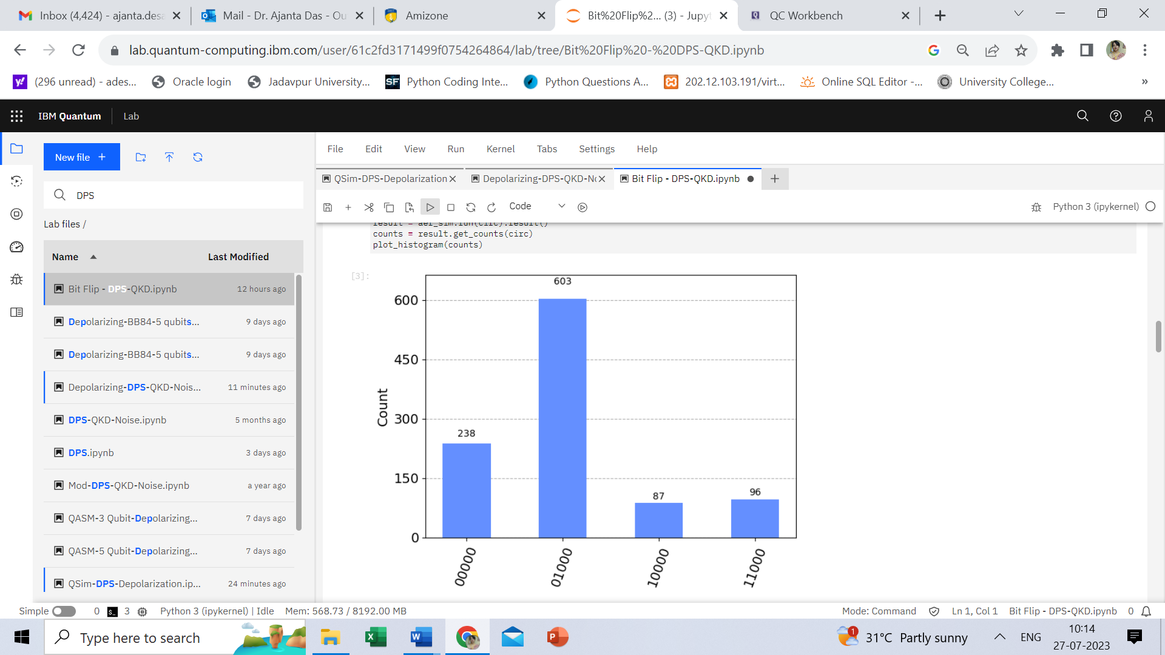
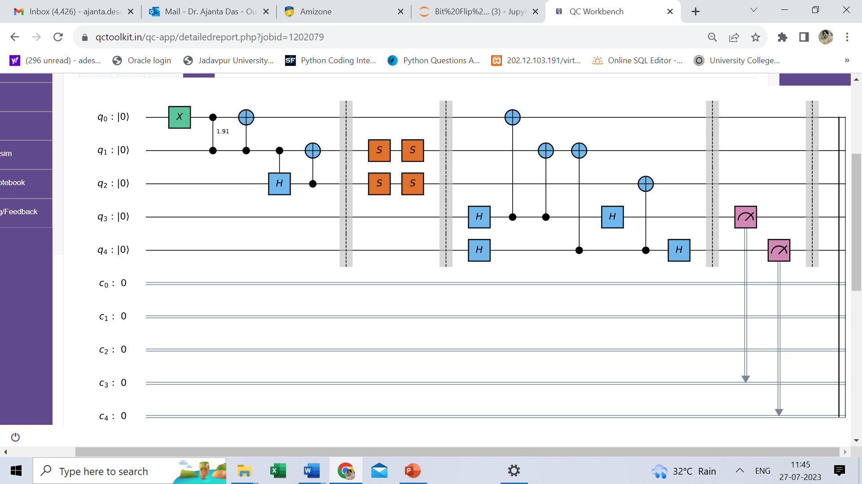
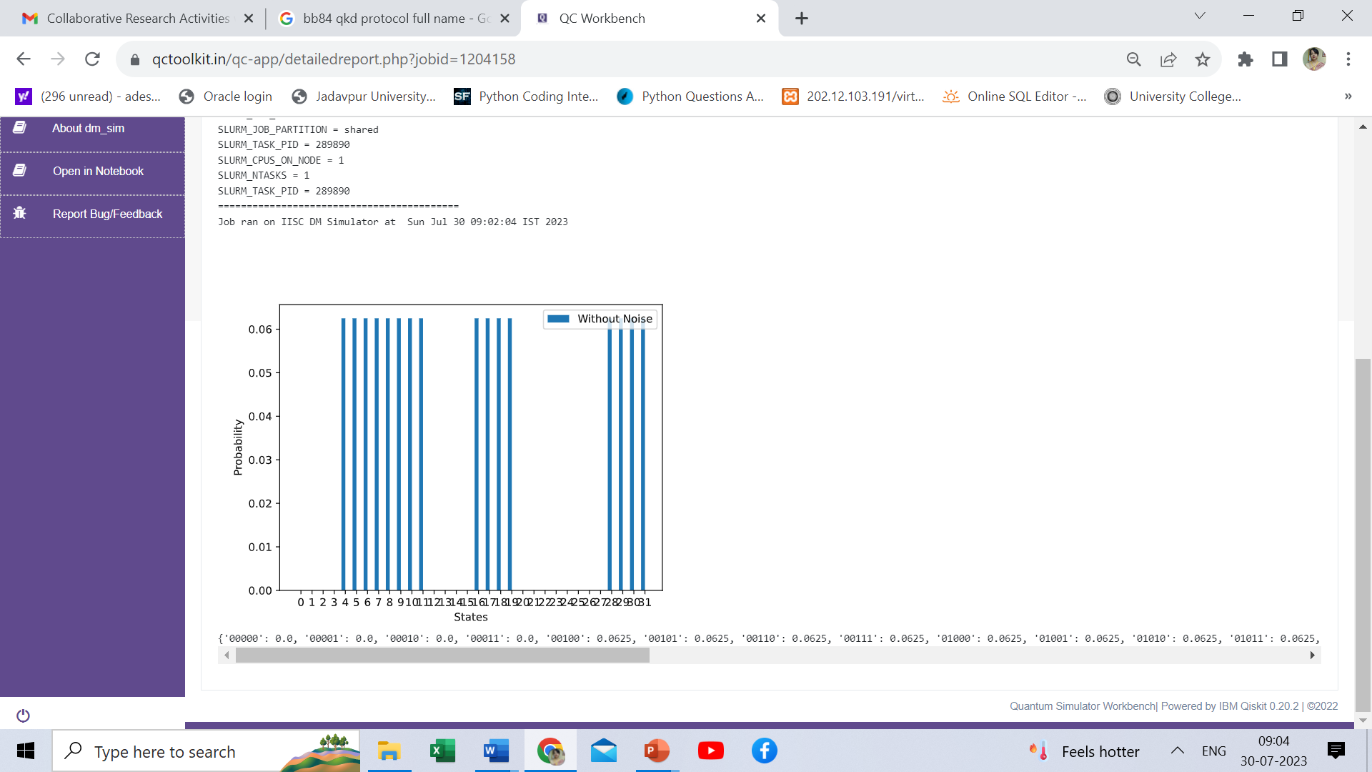
Ideal DPS - QASM Vs QSIM
QASM
QSIM

Slide 18
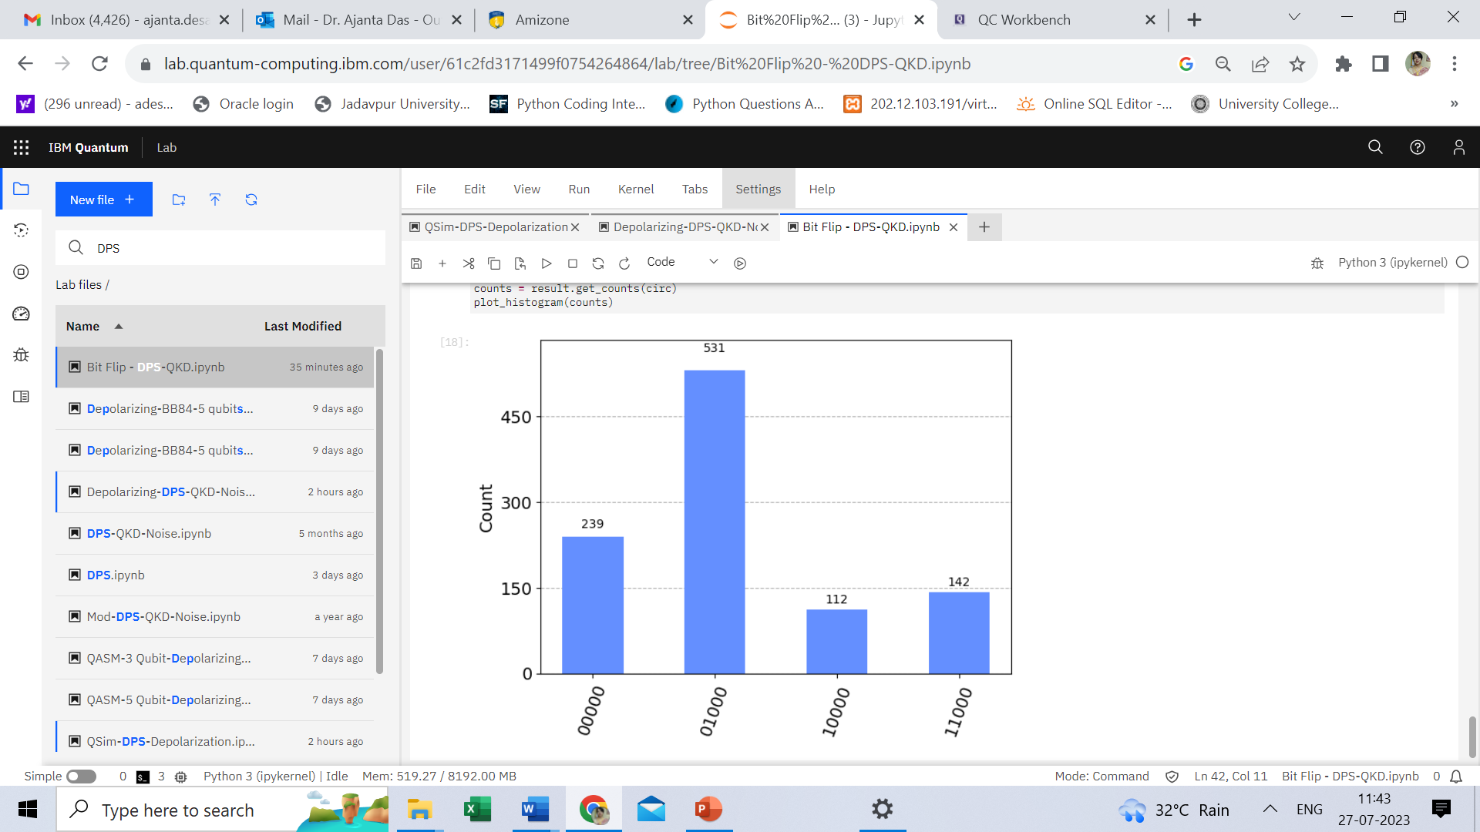
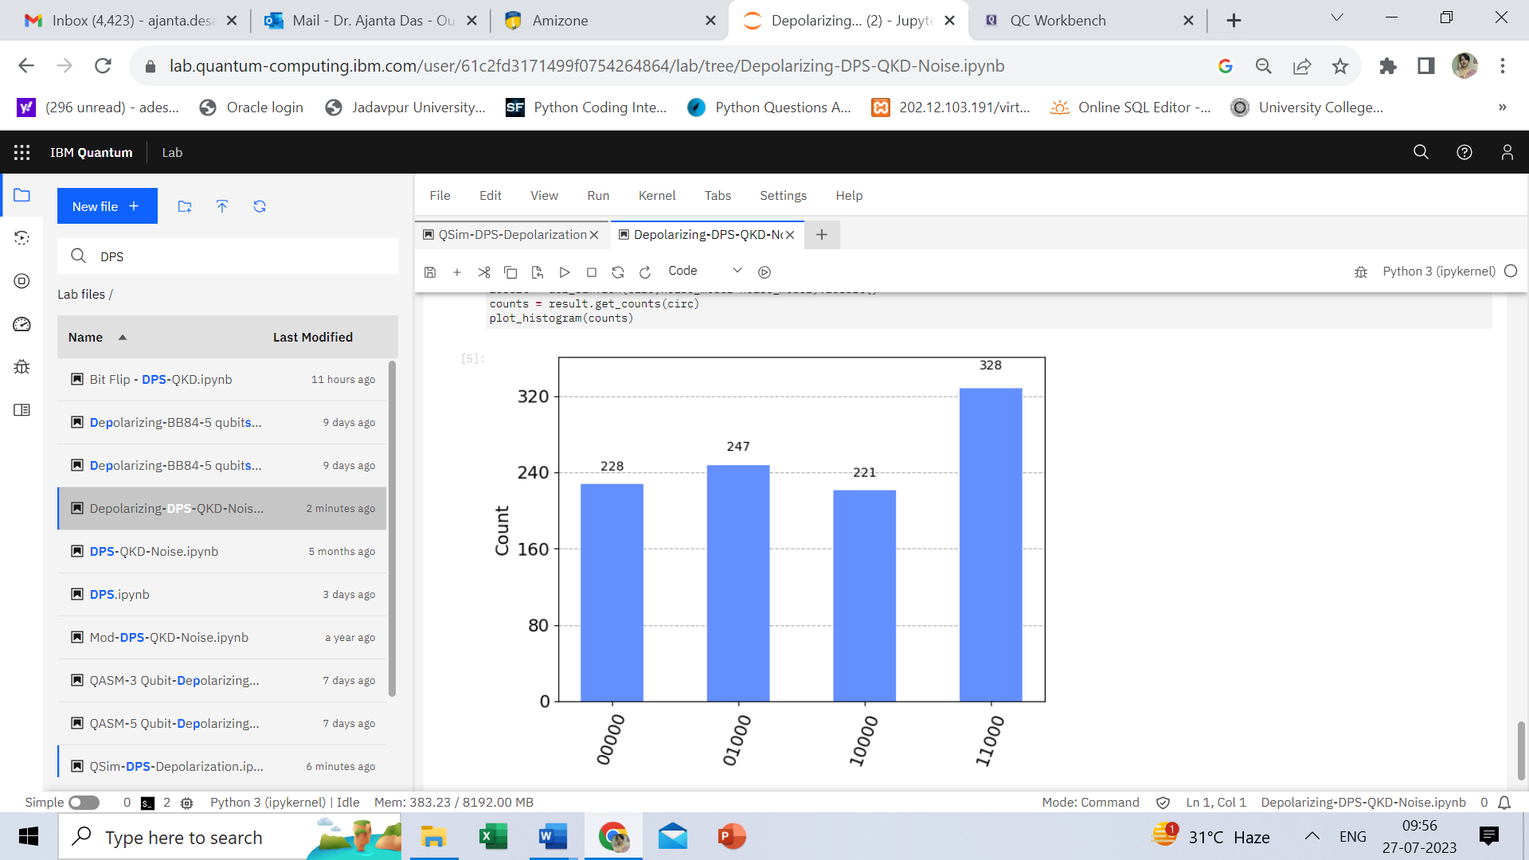
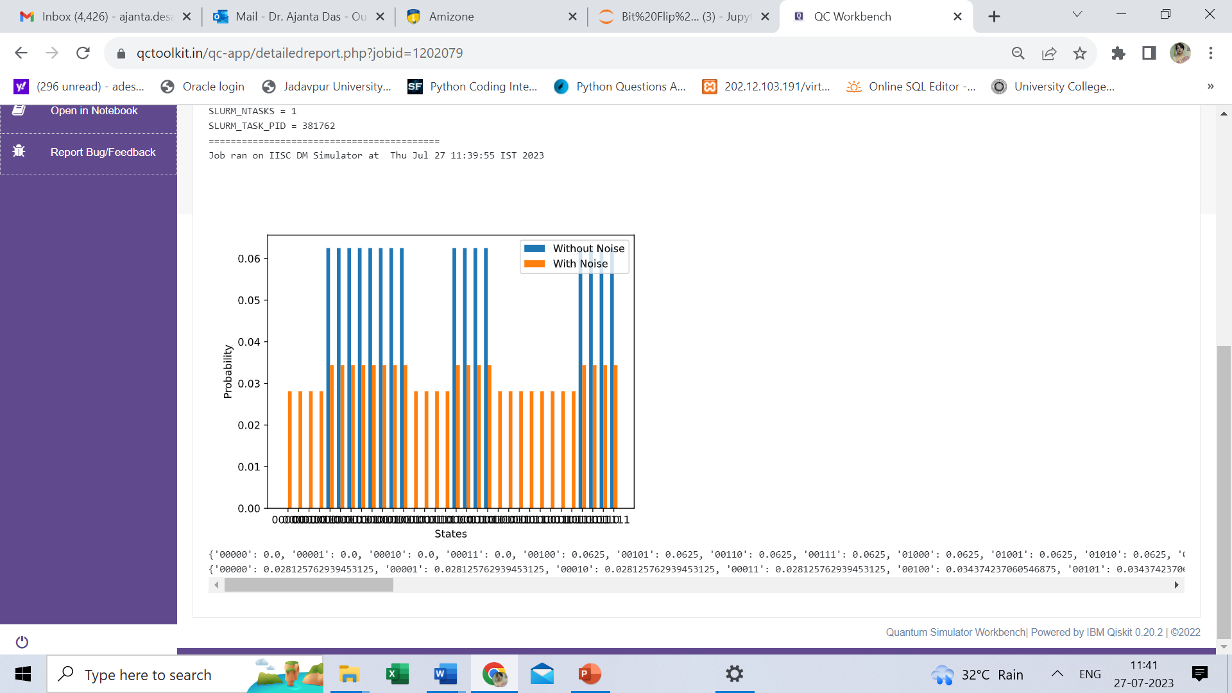
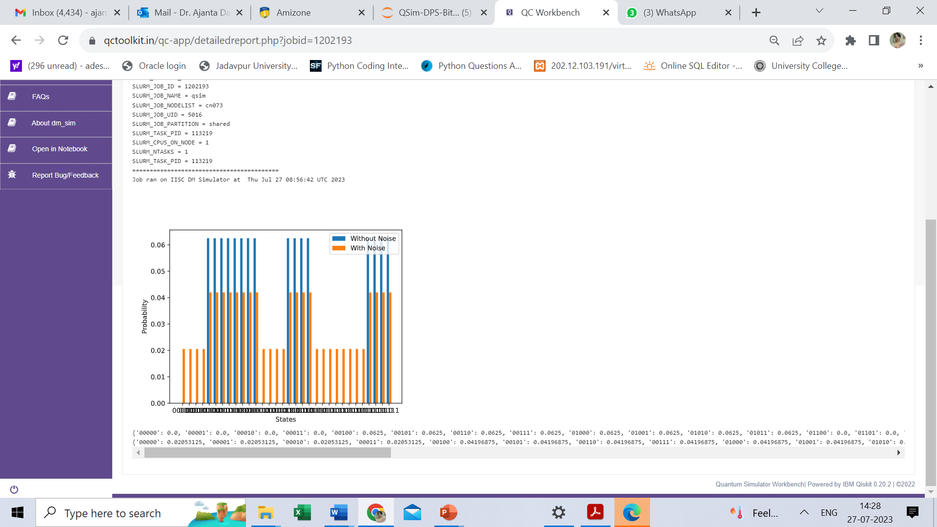
Noise Models - QASM Vs QSIM DPS
DEPOLARIZATIO
N
BIT
FLIP
10%=0.1
QASM
70%=0.7
QSIM

Slide 19
Observations and Analysis
In case of Ideal models, both simulators QASM and QSim produce identical results
In case of Noise models, results for QASM and QSim vary:
Complexity increases with increase of Qubits, hence noise propagates or spreads more
Logic operations are different – mathematical formulations are different
QASM uses Least Significant Bit first and Most Significant Bit last; QSim uses conventional: Most Significant Bit first and Least Significant Bit last
QSim is slower that QASM, as it produces the complete output probability distribution in one run. However, QASM requires multiple runs of the same program to verify the purpose

Slide 20
Conclusion
Quantum Key Distribution Protocols – BB84 and Differential Phase Shift (DPS)
Simulations of BB84 in QASM and QSim
Simulation of Circuit and Channel Noise models of BB84
Simulations of DPS in QASM and QSim
Simulation of Circuit and Channel Noise models of DPS
Comparison between results achieved in QASM and QSim simulators
Future Scope:
Essential to understand gap between real environment and simulators
Study of security impact using Noise models

Slide 21
References
N. Alshaer, A. Moawad and T. Ismail, "Reliability and Security Analysis of an Entanglement-Based QKD Protocol in a Dynamic Ground-to-UAV FSO Communications System," in IEEE Access, vol. 9, pp. 168052-168067, 2021, doi: 10.1109/ACCESS.2021.3137357.
Peng-Liang Guo, Chen Dong, Yi He, Feng Jing, Wan-Ting He, Bao-Cang Ren, Chun-Yan Li, and Fu-Guo Deng, "Efficient quantum key distribution against collective noise using polarization and transverse spatial mode of photons," Opt. Express 28, 4611-4624 (2020).
K. Lim, H. Ko, K. Kim, C. Suh and J. -K. K. Rhee, "The Error Tolerance Bound for Secure Multi-Qubit QKD Against Incoherent Attack," in IEEE Journal of Selected Topics in Quantum Electronics, vol. 21, no. 3, pp. 178-186, May-June 2015, Art no. 6600809, doi: 10.1109/JSTQE.2014.2369498.
Konstantinos Georgopoulos, Clive Emary, Paolo Zuliani, “Modelling and Simulating the Noisy Behaviour of Near-term Quantum Computers”, Phys. Rev. A 104, 062432 (2021), DOI: https://doi.org/10.1103/PhysRevA.104.062432.
Himanshu Chaudhary, Biplab Mahato, Lakshya Priyadarshi, Naman Roshan, Utkarsh, Apoorva D. Patel, “A Software Simulator for Noisy Quantum Circuits”, https://arxiv.org/abs/1908.05154, 2019, DOI: 10.48550/ARXIV.1908.05154.
IBM Quantum Simulators, https://quantum-computing.ibm.com/lab/docs/iql/manage/simulator/
Jupyter Notebook: https://jupyter.org/
Learn Quantum Computation using Qiskit: https://qiskit.org/textbook/ch-algorithms/quantum-key-distribution.html

Slide 22
References
Michael A. Nielson and Isaac L. Chuang, “Quantum Computation and Quantum Information”, 2010, Cambridge University Press, 978-1-107-00217-3.
Noson S. Yanofsky and Micro A. Mannucci, Quantum Computing for Computer Scientists. Cambridge: Cambridge University Press, 2008, doi:10.1017/CBO9780511813887.
Omer K. Jasim, Safia Abbas, El-Sayed M. El-Horbaty, Abdel-Badeeh M. Salem, “Quantum Key Distribution: Simulation and Characterizations”, Procedia Computer Science, Volume 65, 2015, Pages 701-710, ISSN 1877-0509, https://doi.org/10.1016/j.procs.2015.09.014.
Philip Kaye, Raymond Laflamme and Michele Mosca, “An Introduction to Quantum Computing”, Oxford University Press, 2007, 978-0-19-857000-4.
Qsim – Quantum Computer Simulation Toolkit, https://qctoolkit.in/.
14.. Rakesh Saini, Ankit Papneja, Bikash K. Behera and Prasanta K. Panigrahi, “Experimental Realization of Differential Phase Shift Quantum Key Distribution on IBM QX”, Preprint Dec 2019, DOI: 10.13140/RG.2.2.10904.14089.
15. Inoue, Kyo and Waks, Edo and Yamamoto, Yoshihisa, “Differential Phase Shift Quantum Key Distribution”, PhysRevLett.89.037902, Vol 89, Issue 3, pages 037902 – 037904, 2002, American Physical Society, DOI: 10.1103/PhysRevLett.89.037902
16 Riley T. Perry, “The Temple of Quantum Computing”, December 2004.

Slide 23

THANK
YOU

